Slide 1
Special Session: AI-Guided Signal Processing for Efficient, Controllable, and Interpretable Audio Enhancement
Pejman Mowlaee, Jesper Rindom Jensen, Tim Fingscheidt
GN A/S, Ballerup, Denmark
Aalborg University, Aalborg, Denmark
TU Braunschweig, Braunschweig, Germany
September 9, 2024

Slide 2
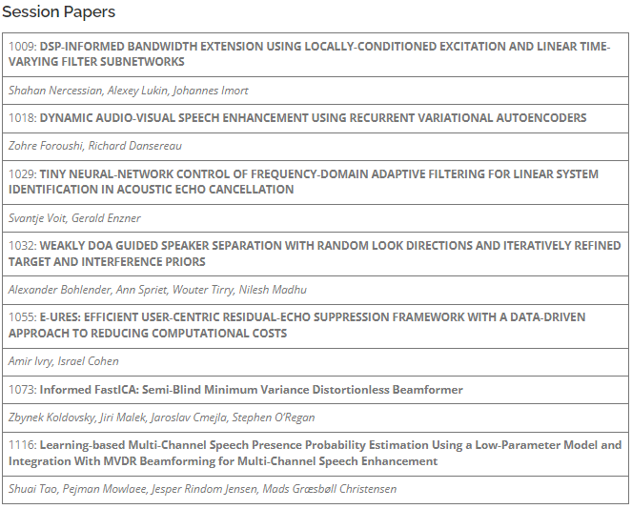
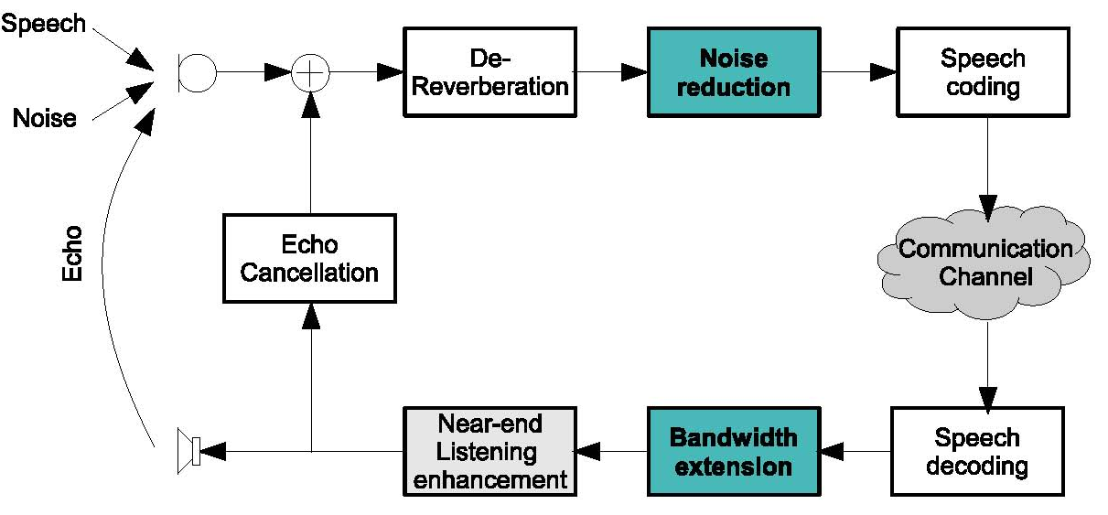
Special Session: AI-guided signal processing for efficient controllable, and interpretable audio enhancement
When: Tuesday 10.09.2024 @ 10:00-12:00 Poster Session Poster Area 1 (TU1.P1)
Organizers: Pejman Mowlaee, Jesper Rindom Jensen and Tim Fingscheidt
Focus:
exploit domain-expertise to break down the audio enhancement problems
identifying meaningful ways of using machine learning in combination with traditional audio signal processing.
enabling the use of smaller and more efficient machine learning models,
bringing back the flexibility, controllability, and interpretability of signal processing approaches
leveraging the robustness of data-driven approaches.
Topics:
Optimal filtering + machine-learning-based statistics estimation
Data-driven beamformer designs
Hybrid methods: statistical signal processing and machine-learning-based
Blind source separation and extraction guided by machine-learned models
Enhancement/extraction methods guided by machine learning (e.g., for target selection)
Submitted contributions overview
Multi-channel signal enhancement
Source separation
Bandwidth extension
Echo Control
Speech intelligibility enhancement
Audio-visual speech enhancement
…

